Slide 1
Cloud-based Sounder and Microwave Instrument Data Processing Infrastructure for DBNet
CSPP User's Group Meeting 2019
Bruce Flynn/Liam Gumley
UW Space Science and Engineering Center
brucef@ssec.wisc.edu

Slide 2
Overview
Introduction to WMO DBNet
Receiving stations
Traditional Participation
Challenges
Regional Challenges
DBNet Cloud Service
Origin
Overview
Advantages
Technical Details
Science Software Distribution
Monitoring / Metrics / Quality Control

Slide 3
WMO DBNet
World Meteorological Organization
https://www.wmo.int
Low latency IR and MW Sounder data for NWP
Developed from EARS
EUMETSAT Advanced Re-transmission Service
Global scope
Advanced sounders (IASI, CrIS, ATMS, IRAS, MWHS)
Disseminated globally
Global Telecommunication System
DVB-S
Regional Participants
EUMETSAT (Europe)
NOAA (North America)
CMA, BoM, KMA, JMA (Asia Pacific)
INPE, DMC (South America)

Slide 4
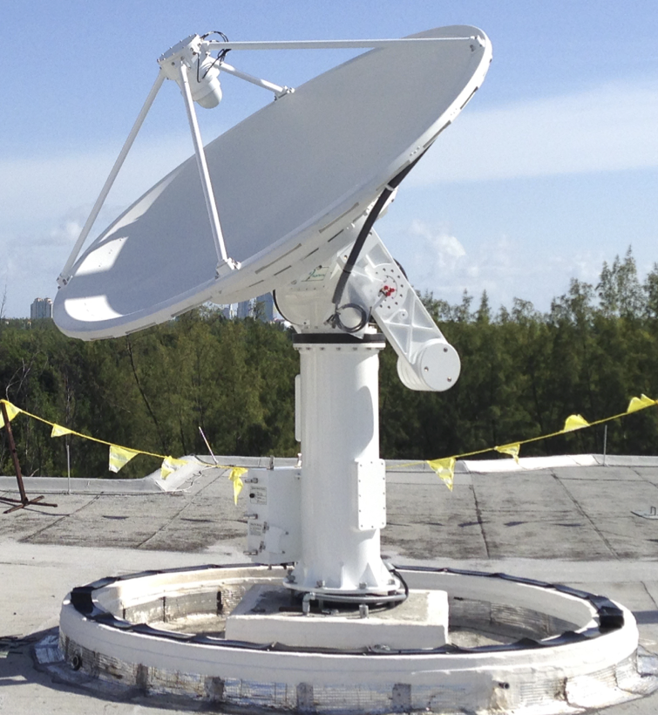
Receiving Station: Traditional Participation
Traditional participations seems straight forward until all the details are considered.
Install
L1B Processing Software
CSPP SDR
OPS-LRS
AAPP
BUFR conversion
Etc ...
GTS Headers
Acquire/Decode
Process
Upload
Operational Loop
Orbital Systems X/L-band 2.4m Antenna, Miami, Florida
Photo courtesy of Liam Gumley

Slide 5
Receiving Station: Traditional Participation
Operational Loop
Acquire/Decode
NOAA RDR
Process
Level 0 to Level 1B​
Upload
Regional Network​
MetOp CCSDS
NOAA HRPT
BUFR conversions
Compression
Add GTS headers
Anonymous FTP
Automated
Notes:
Adding a receiving station
Larger item

Slide 6
Receiving Station: Challenges
System Requirements
CPU cores, RAM, Disk
Operating System
Software Logistics
Version Updates/Patches
Configuration
Testing
Networking
Security/policy restrictions
Bandwidth
Ancillary/LUTs
Updating Ancillary Cache
Monitoring/Metrics/QC
Funding Constraints
Keeping LUTs up to date
System monitoring/metrics
Product monitoring
Notes:
System requirements
Number of CPU cores
RAM requirements
Disk
Operating System
CSPP SDR -- RAM: 48G, Disk 100GB, CentOS >= 6.9
Software logistics
Keeping software up to date
Patches
Major version updates
Configuration
Testing
Networking
Security/policy restrictions
Bandwidth
Keeping ancillary/LUTs up to date
Ties back into networking
Monitoring/QC
Funding restraints

Slide 7
Regional Challenges
Challenges at the regional level mostly derived from traditional model at the receiving station.
Latency
Goal: < 20 minutes
Cutoff: 30 minutes
Quality
Consistent with Global Data
Ancillary/LUTs
Versions
Support
Personnel availability
Software Diversity
Station Diversity
Support Contracts
New Satellites
Notes:
Challenges

Slide 8
DBNet Cloud Service
The goal is to provide an easy way for DB station operators to contribute to DBNet while providing a consistent, high quality product with the latency required for NWP.
To make this happen we need to improve upon the tradition model for participation in DBNet.
Reduce burden on receiving station operators
Increase reliability/uptime
Scalability
Reproducible deployment
Product/software transparency
Maintain Latency

Slide 9
Improving the Model
Centralize processing
Does everyone really need to solve the same problem?
Client uploads level 0 or raw data
Use existing, vendor provided, automatic upload capabilities
Tooling
Bandwidth reduction
hrptprune/compression, ccsdsprune
Easter island receiving station

Slide 10
Background: DbRTN
DBNet Cloud Service is based on work done on the existing NOAA DbRTN project.
NOAA DBRTN
Located @ UW SSEC
5 UW Antennas
11 Partner Antennas
NOAA
CrIS, ATMS, IASI BUFR data, since 2016
ATOVS BUFR data since May 2019
Dissemination on GTS
EUMETSAT
CrIS, ATMS, IASI BUFR data since 2017
ATOVS BUFR Data since May 2019
Dissemination on EUMETCAST (pilot service)
Core Services
API/Metadata Services
Processing System
Ingest System
DBPS
Listing/Client Notification
Notes:
Creds for Liam
More readable
Make it clear this is the legacy system

Slide 11
DBNet Cloud Service
Core Components
Core Services
Processing/File APIs
Metadata DB
Metrics/Monitoring/Alerts
File Depot
Client Data Dropbox
Data Integrity
Processing Node
Management
Notes:
Core
Processing API
Metadata DB
Metrics
Monitoring
Alerts
File Depot
Data Ingress
Secure Upload
SFTP, HTTPS
Insecure Upload
FTP
Virus Scanning
Processing Node
Scale Horizontally
Mangement

Slide 12
Core Services
Processing/File APIs
Job selection for processing nodes
Report processing status/metrics
Provide monitoring data
Metadata Persistence
PostgreSQL
Monitoring/Metrics/Alerts
Prometheus/Alertmanager, Grafana
Hardware, software metrics
Site, file, and processing metrics
Provenance
Messaging
RabbitMQ Message Broker
Asynchronous Events
Reduces coupling
Real-time
Product availability and latency
Notes:
What is the technology providing
2/3 bullets

Slide 13
File Depot
Client Data Dropbox
SFTP, HTTPS, FTP
Data Integrity
Checksums of incoming files
Asynchronous Notifications
Makes file listings unnecessary
Virus scanning
IP Restricted
SSH Public Key Authentication
Reduce latency
Quarantine
SFTP, HTTPS, FTP
Incoming
Available for processing

Slide 14
Processing Nodes
Run Science Software
Update Ancillary
Manage Software
Select jobs to run
Report status
Report metrics
Update LUTs
Interact with API
GTS Headers
BUFR Conversion
OPS-LRS
AAPP
CSPP SDR
Processing node can be responsible for running one or more science package for any combination of satellite and/or sensor.
Notes:
Composable
By processing task
By satellite/sensor
The software
CSPP SDR, GTS headers, etc...
Update / track job status
What they do, not how you can use them

Slide 15
DBNet Cloud Service: Management
Configuration Management
Reproducible deployment
Uptime/Reliability
Redundancy
Scaleability

Slide 16
DBNet Cloud Service prototype
3 Stations
SSEC, Guam, Puerto Rico
Processing
CrIS, ATMS (SNPP, NOAA-20)
NOAA-18/19, Metop-A/B/C
No Delivery
AWS Cloud Services (IAAS)
EC2
Not using AWS SAAS
No vendor lock
No S3 storage
File Depots
Currently running in multiple regions
Asia Pacific, US East
Single processing Node
Metrics/Monitoring is a work in progress
Notes:
alpha

Slide 17
Tehcnologies: Tools
hrptprune
Select/prune CCSDS application packets
Zero-out TIP/Image data
MetOp-A/B/C
NOAA-18/19
ccsdsprune
https://gitlab.ssec.wisc.edu/brucef/hrptprune
https://gitlab.ssec.wisc.edu/brucef/ccsds-go

Slide 18
Tehcnologies: Containers
Docker
Reproducible
Dependency encapsulation
Science Software
Very simple deployment of new versions
Security model more appropriate for science software
Can be created by anyone
Encapsulation
Facilitates Dev-Ops
Singularity
Infrastructure/Services
Configuration Mgmt. Integration

Slide 19
Tehcnologies: Management
Ansible
Configuration as code
Push not pull (Puppet)
Terraform
Infrastructure management/provisioning
Persists to revision control
Infrastructure as code

Slide 20
Summary
It works!
Model proven based on the legacy system
Gaining more partner antennas
More modern infrastructure design
Maintainable
Uptime/reliability/scalability
Bruce Flynn
brucef@ssec.wisc.edu

